Slide 1
2021 Arcade Documentation - Python Project
By Alex Horst

Slide 2
Project Management
The software I used to code the program, Pycharm, has a feature where you can see all the versions that have been previously saved. This helped me a lot as I was able to not exactly worry about doing it somewhere else - I have many versions that are saved in Pycharm. It is free to download and it’s copyright free for the community, and it’s recommended by experienced programmers.
I used Mu before Pycharm for a brief time but I realised that Pycharm was designed much better, it had many different features that Mu failed to show in its program (I explain these later). I do have a version saved on Mu however it doesn’t track back to when I first started so this was a massive problem for me.
I will take the data from my Pycharm versions and I will record them on a google doc - the link is here:
https://docs.google.com/document/d/1WQkhvT8ene0mGCIG9hddVlaQGx-nG7BAPtkYGVAO2O4/edit

Slide 3
Link to the Plan:
https://docs.google.com/document/d/1toSZnPCJRIm80mTwX_8URtAayhEwRgm6JAwjPEnmMwA/edit
This shows what I decided to do and why - it’s a summary of my choices.

Slide 4
The basic process I used to make the arcade
Firstly, I had to start with the main arcade file - it had to be the fundamental file because it was how the user had to get into choosing and playing the games.
I then moved onto planning the adventure game. It is a fully original concept and I’ve had to come up with everything myself. I’ve had to create a lot of different files because there are many choices that the user would’ve had to make and it would have been a nightmare to cram everything into one file. I got a lot done before I planned out the next game
I then started my paper scissors rock game - I looked online for inspiration and not too long after, I’d effectively found a way for me to make the game. At this stage I hadn’t found a way to loop the code 10 times, so I copied and pasted the code and changed the numbers for each choice/round.
Then I decided to change up my original number game idea to a number quiz, this was the final completed game I ended up making. I picked a very large variety of questions, with different skills needed to get through every one. I then made the process in which the questions would be triggered as the quiz goes by - storing the questions in a list, then making a command so that the questions would appear as the list number goes up
At the end of getting everything kind of set up, I worked on everything simultaneously - modifying, expanding and testing the code as I went along the project. I was able to change a lot of things as I worked on my code, of course there was always something I had to touch up/change entirely. I added new features that I thought were necessary to my code as the project came together.
I did have to make a lot of things on the final day because of an idea I got, and it changed the code massively - it worked better than before.

Slide 5
Estimating how big everything had to be (task sizing)
To get excellence, I believed I needed to have a minimum of three games. This is because with an arcade in real life, there are many different games that the player can choose from. I decided to take this same principle and apply it to my ‘virtual’ arcade, to prevent the user from getting bored. If I’d put two games in I feel like the user would want to get away from the arcade too quickly - in my opinion I’d like the user to explore a lot of different things on the arcade. Having two games wouldn’t take up much time at all to complete, and usually we see people go to arcades to play multiple different games. Therefore three or more games gives me that assurance that the user is able to discover a lot. And having one game would probably be a waste of time.
The thought I had while making the arcade was ‘the bigger the better’ which I applied to all of the games. My adventure game has a lot of different situations so I’m happy with the length I made the arcade. To be honest I could’ve included more if I didn’t encounter some certain problems which I talk about later.
I wanted the paper scissors rock to be fairly extensive in terms of the length. Usually paper scissors rock is usually over very quickly so I decided to extend it, to make it a competition with the computer, in a best of 10 situation with a tiebreaker if the scores are equal after 10 rounds. I felt like this was an appropriate call to make, I didn’t want the game to be too short, 10 rounds is an appropriate length.
Quizzes shouldn’t take long to complete, especially quizzes with multi-choice answers (which this number quiz has). In the quiz I chose to make 20 questions which I feel like is an appropriate length. The questions vary in difficulty

Slide 6
How difficult was everything to make?
By far the hardest game to make was the adventure game. I had to make all of the different scenarios depending on what the user chose. I kept finding unfinished situations in my files and on the last day I really had to work hard to get all of those scenarios completed - yes/no questions, multiple choice options, and so on. However by then there was a way to finish, I just hadn’t set up everything I had to. It was a hassle to get it done because I’d come up with so much but I was able to complete all of the code before the due date.
The second hardest thing to make was the paper scissors rock game. You will see later that I had trouble trying to set up a loop that I could make the code go for ten times before stopping. To make it easier for myself at the start I had to copy and paste the code 10 times, resulting in a very, very long file which in my opinion had to be cut down. However a few days before the code was due I was finally able to find a way to loop my code, changing the rounds and score as the code progressed. I’m very happy that I was able to make this work - if I hadn’t done that then I would’ve been stuck with a 1,100 line file.
I felt like the easiest game to make was the number quiz. All I had to do was come up with the questions, which didn’t take long to do. Using the time library was very easy and I barely spent any time on that. The function to trigger the questions in the list didn’t require much work either which was good. I’d perfected the number quiz well before anything else.
My code required a main file which wasn’t too hard to set up. There were some aspects that were hard to set up, and some that I couldn’t get rid of or else the code would break. Aside from those it was a breeze to set up all of the other components, I felt like this particular aspect worked really well.
I didn’t know how to set up txt files before the project and I’m glad I do now. I felt like these were a great aspect I could include in my project, these were great for storing results (for number quiz) and the survey of the users (which I’d set up in my main file). The commands to append things in the txt files were not too hard to set up either.

Slide 7
Main File Screenshots with explanation

Slide 8
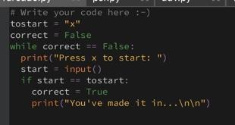
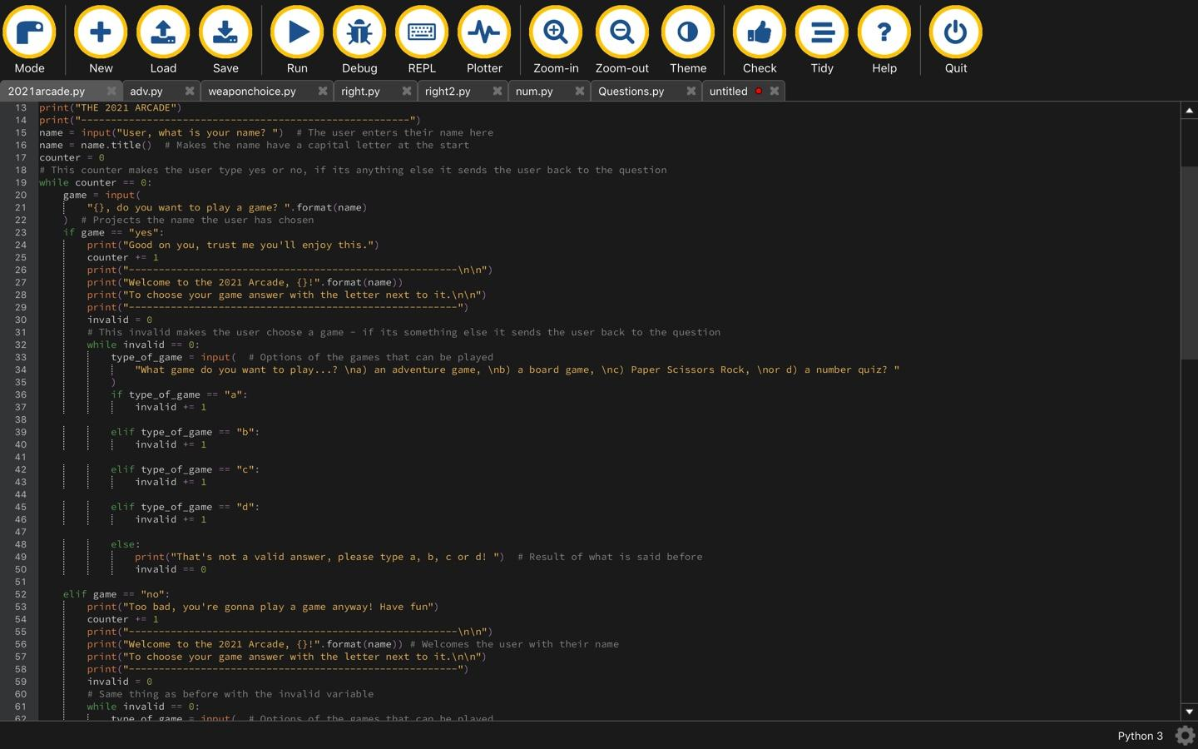
You can vaguely see the comments here but here is the main code for the 2021 arcade home-page, this is where the user enters their name. The counter makes the user play a game, if the answer is invalid the question is shown again. This is also done for the type of game - if an invalid answer is picked the user has to type a correct answer. As of 30th June I have still used these same processes. (Screenshot taken on the 8th June)
This is a system which makes the user have to type ‘x’ in order to get in. Similar to an arcade, where the user has to put coins (or whatever it requires) for the games to make it work. I saw this code in a quiz that I had to do for digital tech and I really liked the concept so I integrated it into my program and changed it to make it feel more ‘arcade-y’.

Slide 9
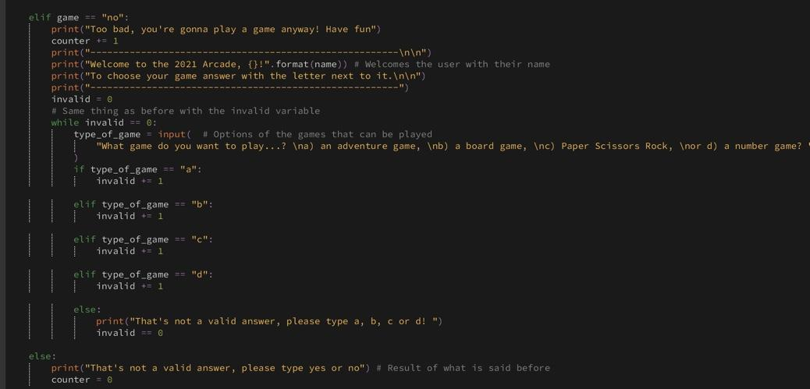
This is continued from the image on the previous page - it basically shows the same things as before but with the ‘no’ instead of ‘yes’ - kinda wanted to do this for fun. If the user types an invalid answer you can see that the counter is at 0 (to make the user play a game) and the invalid is at 0 for any invalid answer (for the type of game). All of this works fine and I have no problems with it as of 8th June (have not modified this since - it works really well). The statements for the type of game are in the next slide...

Slide 10
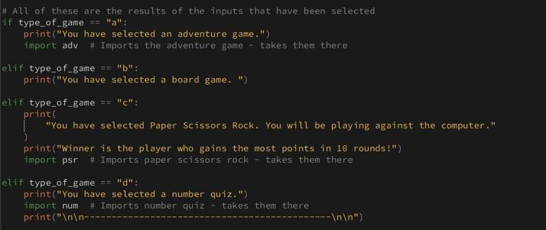
These are the statements that are shown when the user chooses a game. You can see that when the games are chosen, a file is imported. This is purely to save space and make the project more organised. I have done this with all of my games except for the board game which I have not started yet. All of these imports work fine with my code - I am able to play all of the games.

Slide 11
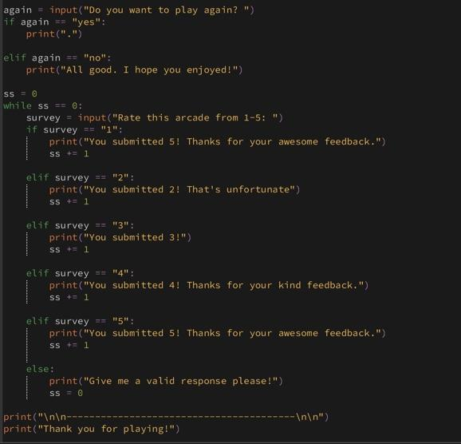
After the user plays the games, I ask the user if they want to play again. I have not yet figured out what I need to do for the yes answer for the again input as of 8th June but I will do my best to figure it out. After the user does not want to play again a survey pops up. This is an original concept which I have not looked online for anything - I ask the user to rate the arcade from 1-5. As you can see each answer has a different print statement attached to it, and I have also included the invalid concept that I used before but under a different name to avoid confusion. If the user types an invalid response the user has to rate the arcade with a correct answer. I have not entirely finished this yet but I’ll invest time into making it happen. I will also comment what each thing does, which I have done on my other screenshots.

Slide 12
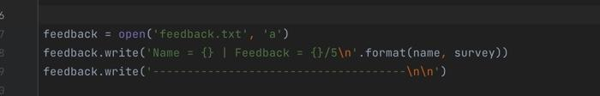
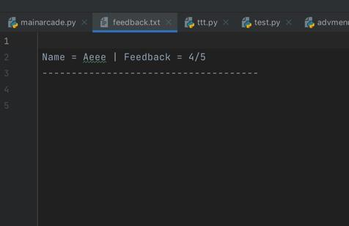
Screenshots will look different now because I switched to Pycharm mid-way through (I apologise for the quality - it’s quite bad!). I managed to create a feature called ‘feedback’ which is a text file. What I’ve done is after the survey is complete, the name and feedback of the user is used in this file, formatted nicely so that the user’s name is clearly visible and so is the feedback number. You can see in the first screenshot that it opens the feedback.txt file and the ‘a’ in the same line means that the text file can be modified. In the next line I write the name and survey of the user, using a process called .format, a process which I use throughout the project. After the name and survey is recorded, I have a line which separates the user’s survey from another user’s survey, there are two new lines called in the line where I write for there to be a line.

Slide 13
Adventure Game Screenshots with explanation

Slide 14
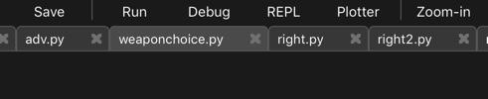
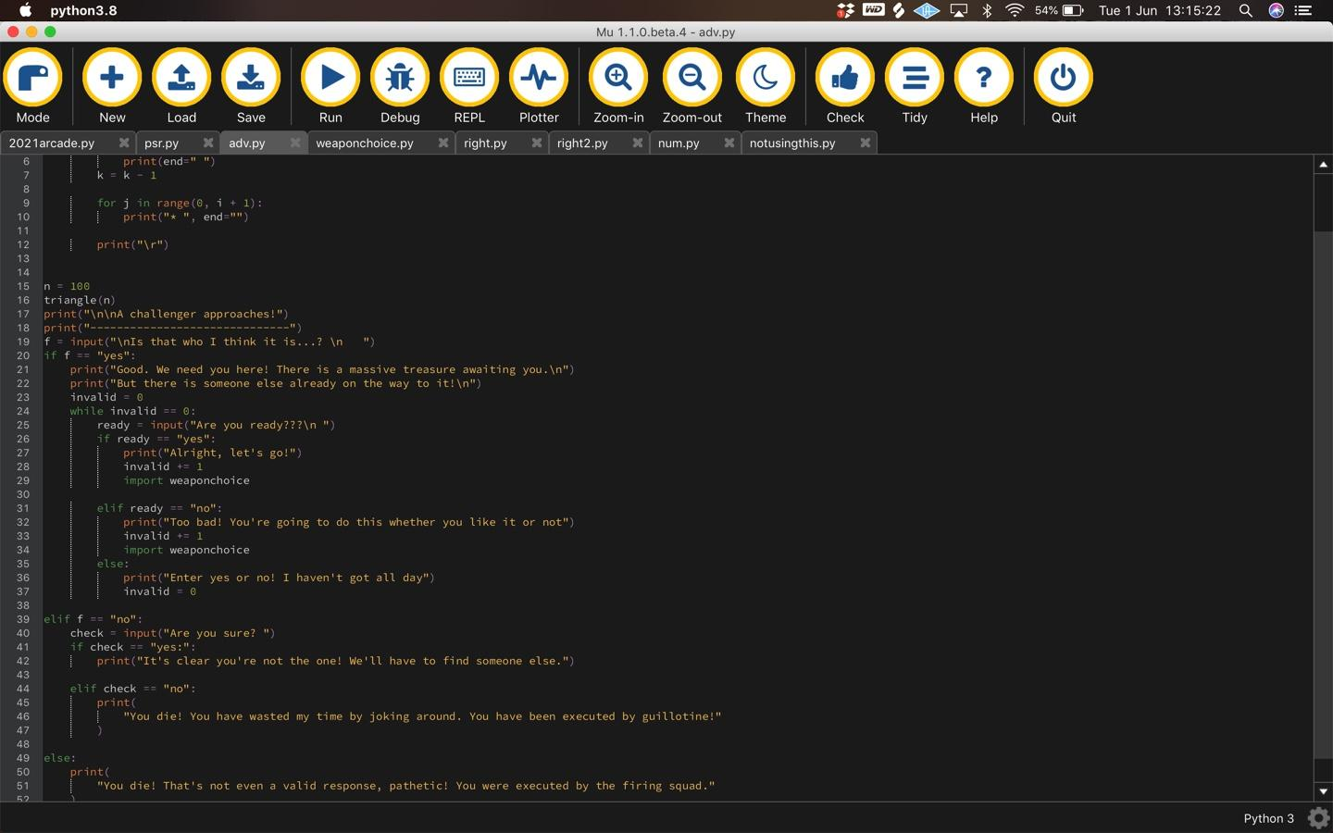
For my adventure game, so far I have four different files that can be imported, shown above. The ‘adv’ file is what shows when the user chooses adventure game from the list of games, as shown to the image to the left. You can see that the user has to state if they’re ready, when they are, the weaponchoice file is imported, more on that in the next slide

Slide 15
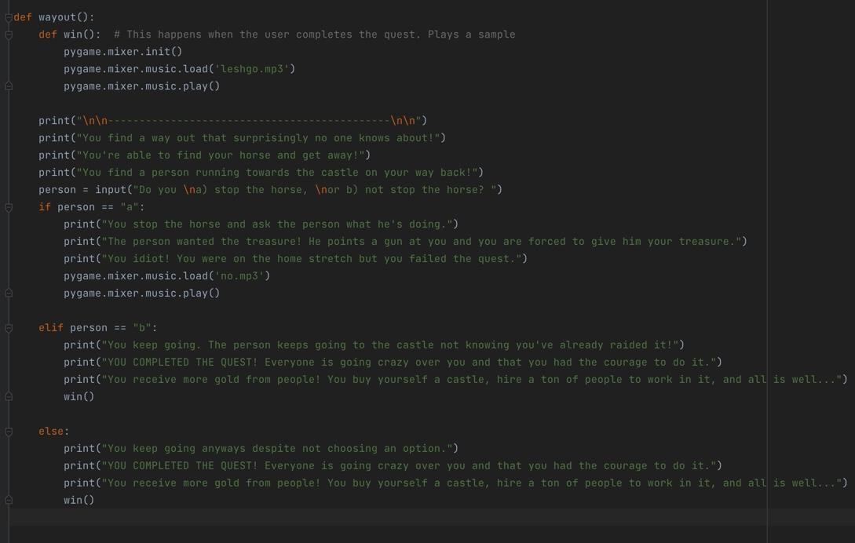
UPDATED (Code from 30 June⬆️): I now have 6 different files for my adventure game. The advmenu is still the same (changed from adv to advmenu, made it easier for me), then I have the weaponchoice file (sorry still more on next slide), then I have three different ‘right’ files based on the weapon choices that the user will make - I decided that if I made multiple rather than one right file, it would make more sense because some of the outputs are based on the weapons that the user chooses, and if it was all the same some of the code would not make any sense. Even though there would be less files, the user would think that the code printed the wrong thing.
I’ll explain the wayout file here though➡️ (finished version): if the user makes it out without failing the quest this file is triggered. The user is faced with one more choice, the user has to keep going here or else the user will fail the quest

Slide 16
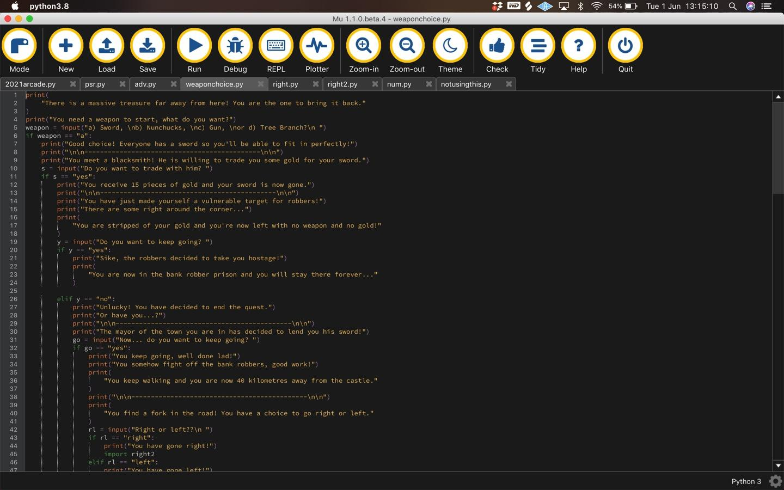
This ‘weaponchoice’ file is the file that is imported when the user is ready. As of 8th of June I have situations for all four weapon choices - Sword, Nunchucks, Gun and Tree Branch. You can only see the sword one in this screenshot but you can see the different situations the user has to encounter when they choose the sword as their weapon. If the user types an invalid response the user has to go with no weapon.

Slide 17

Here is a basic video of me scrolling down the page in the finished weaponchoice file. This has all the code I have written for this file. You can see all of the different weapon choices and what happens depending on which weapon you choose.

Slide 18
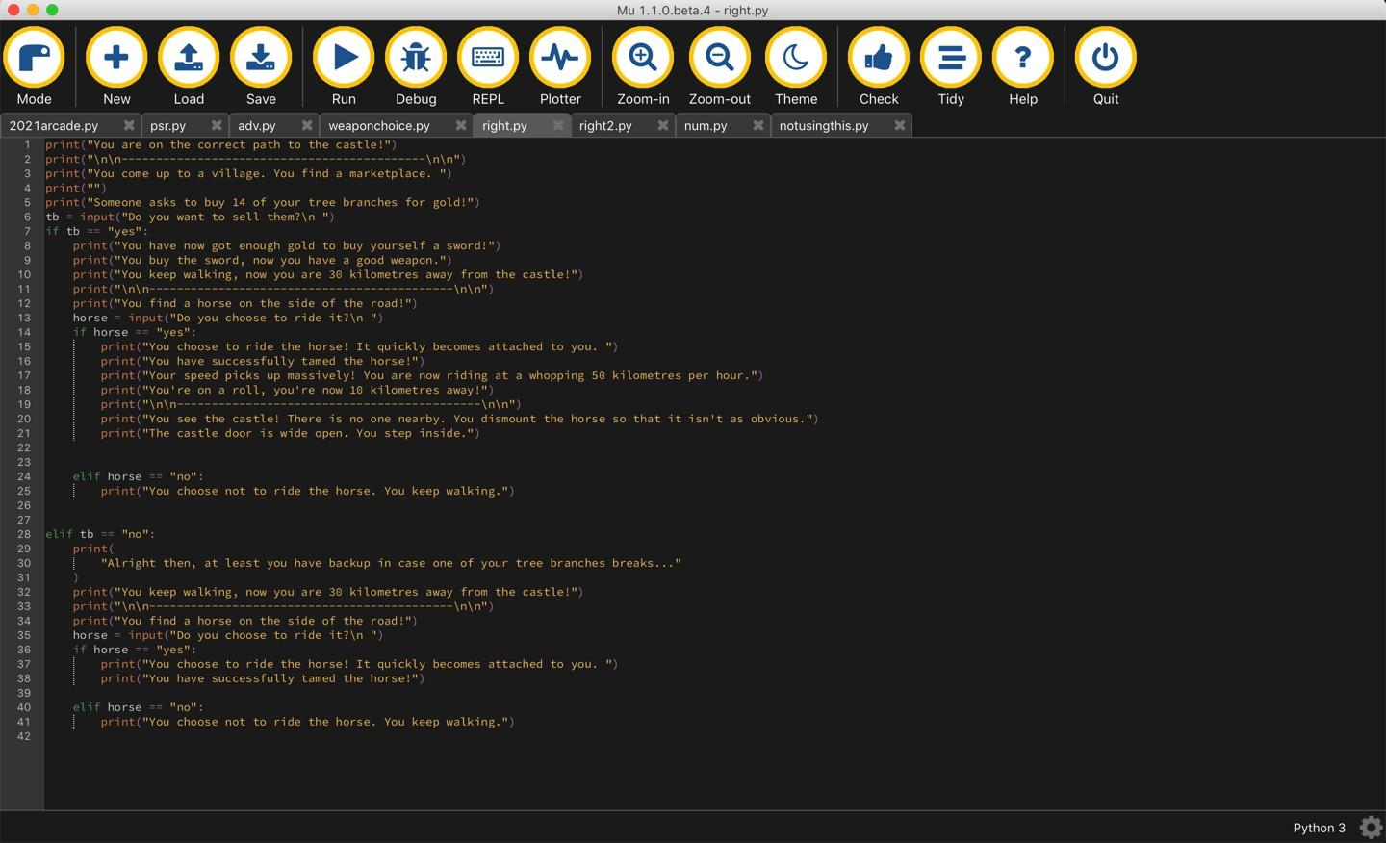
This ‘right’ file imports when the user chooses to go right in the fork in the road. It tells the user that they are on the correct path to the castle, and gives them a few different situations, in which they can choose what to do. As of 8th June this is all I have - it works well so far and there are not many changes I need to make.

Slide 19
This is the updated right file. This video shows the choices the user has if they go right. This triggers if the user chooses to use a Tree branch as their weapon. You can see all of the scenarios here have been fully put together. No sound in this video.

Slide 20
This is similar to the ‘right’ file but this is slightly different because the original right was designed for the tree branch situation. Because there is a question requiring tree branches it would create a fault in the system because the user did not choose Tree Branch as their weapon.
No sound for this video.

Slide 21
This is again similar to the right file but it has slightly different scenarios - this is for if the user chooses the gun as a weapon, it won’t be triggered any other way. All of the scenarios are updated so that the user won’t encounter any bugs. No sound in this video either.

Slide 22
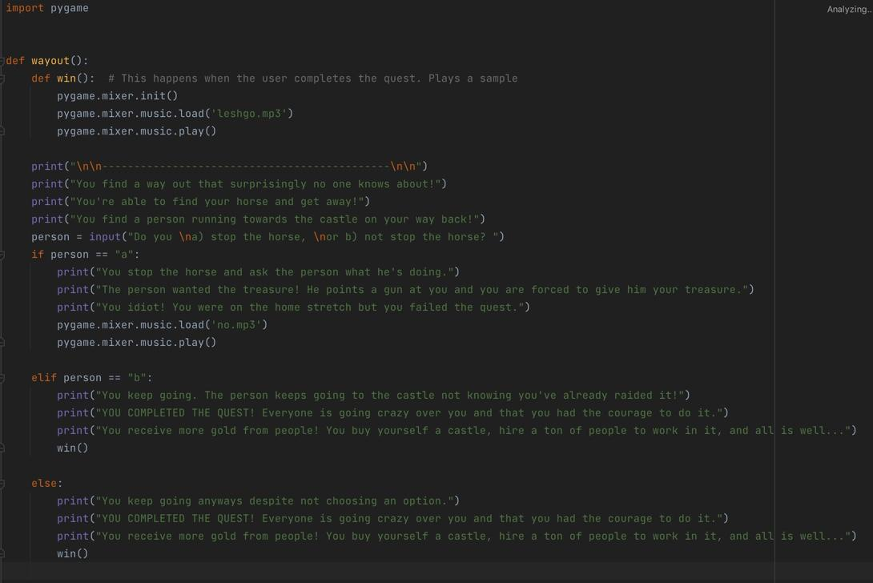
This is the wayout file - this is imported if the user makes it to the end of the game. They are faced with one more choice - they can’t choose the wrong thing or else they would lose the quest. You can see that it’s quite easy to choose the right option - the user deserves to get to the end if they managed to escape past everything else.

Slide 23
Paper Scissors Rock screenshots with explanation

Slide 24
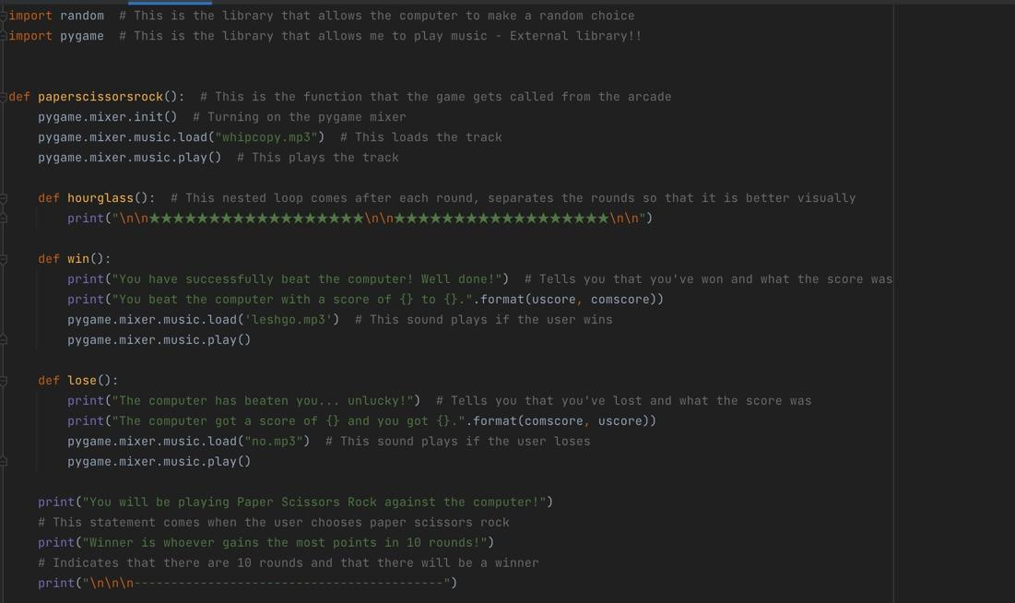
I have two libraries up here - random and pygame. Pygame allows me to play music during the games, you can see at the start of the function that I turn on the pygame mixer, then I load the mixer with one of my tracks, then I play it - it plays throughout the game. Random allows the computer to pick a random choice from the list of possible choices.
You can also see here that I have a ‘win’ and a ‘lose’ function. The win function says you’ve beat the computer, and it shows the score. Then it plays a sample called ‘leshgo.mp3’ - also used in the adventure game. The lose function says the computer’s won, and it says what the score was. I also used the ‘no.mp3’ sample from the adventure game for the lose function too.
Below, you can see that the user has chosen Paper Scissors Rock, and there will be 10 rounds of the game.

Slide 25
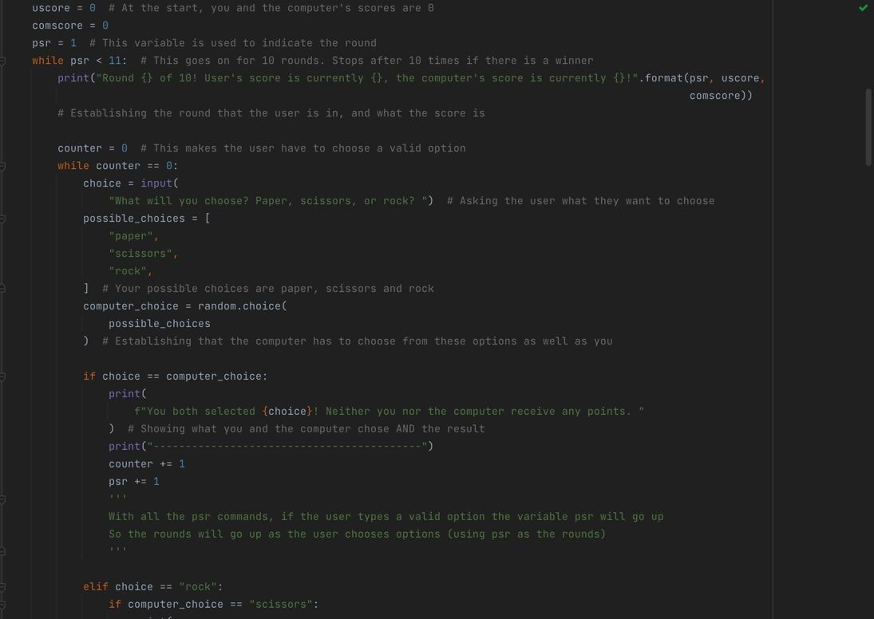
I have made the user’s score and the computer’s score equal to 0 at the start of the game. This makes the game fair for both the user and the computer. These update every time the user wins a round, or the computer wins a round.
You can see that there is a print statement at the start, and I used .format to show the round, which is indicated as psr (starts at 1), the user’s score and the computer’s score. It updates as the user’s score and computer’s score and the round go up.
‘Choice’ asks what the user wants to choose, and the computer has to choose from the list of ‘possible_choices’, using random.choice from the imported random file. This worked perfectly for me, the computer’s choices varied throughout the game.
You can also see that if the user’s and computer’s choices are equal, the round goes up without the user/computer getting any points. The variable called ‘counter’ goes up, this counter variable will make the user choose a valid option - this goes up if the user makes a valid choice. More on this when I show what happens when the user makes an invalid choice.

Slide 26
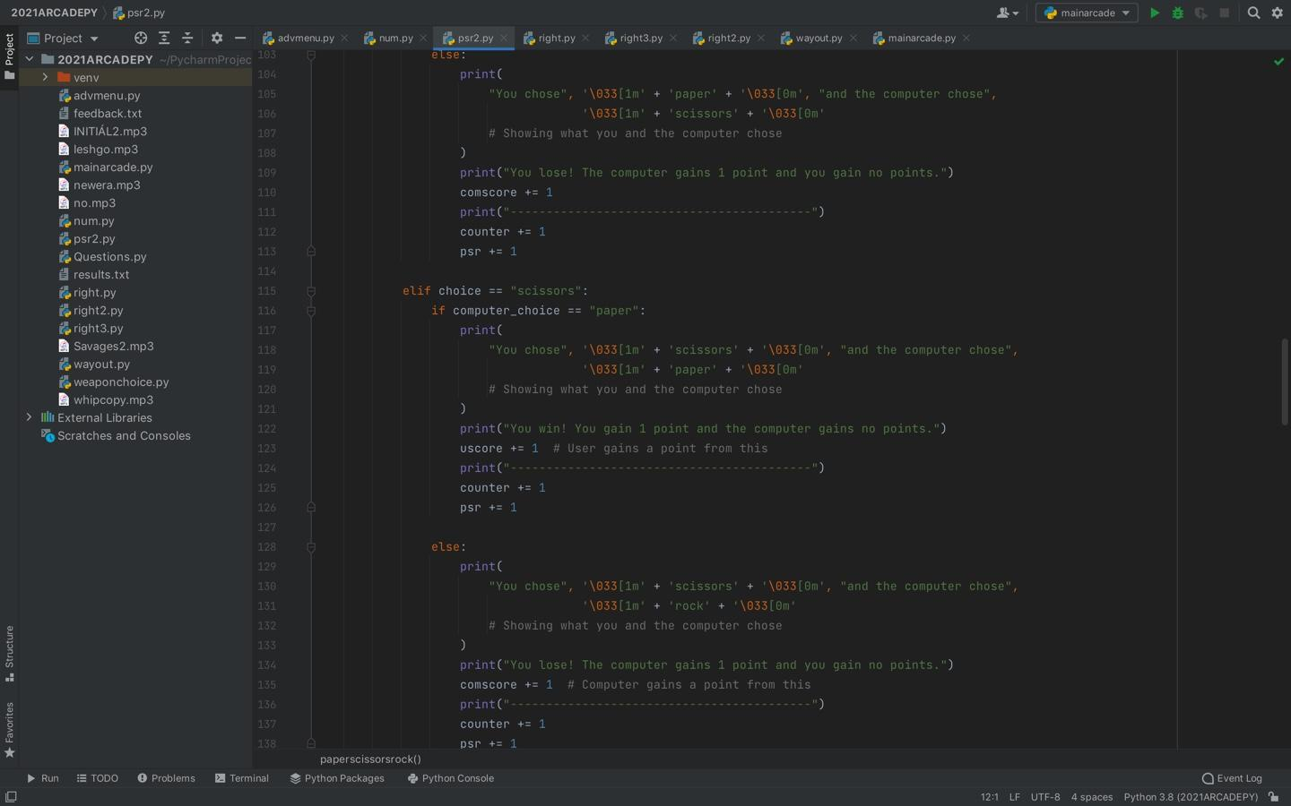
These are pretty basic elements in my program - basically these are the results if the user or the computer wins a round, depending on the choice that the user makes. You can see that it works the same way as normal paper scissors rock, with each choice being linked to what would happen in actual paper scissors rock.
I had no problems with making these throughout me making my code - I was able to make the general idea very quickly, leaving a lot of time to refine it. I was able to do this with recommendations from my mates and my own recommendations.

Slide 27
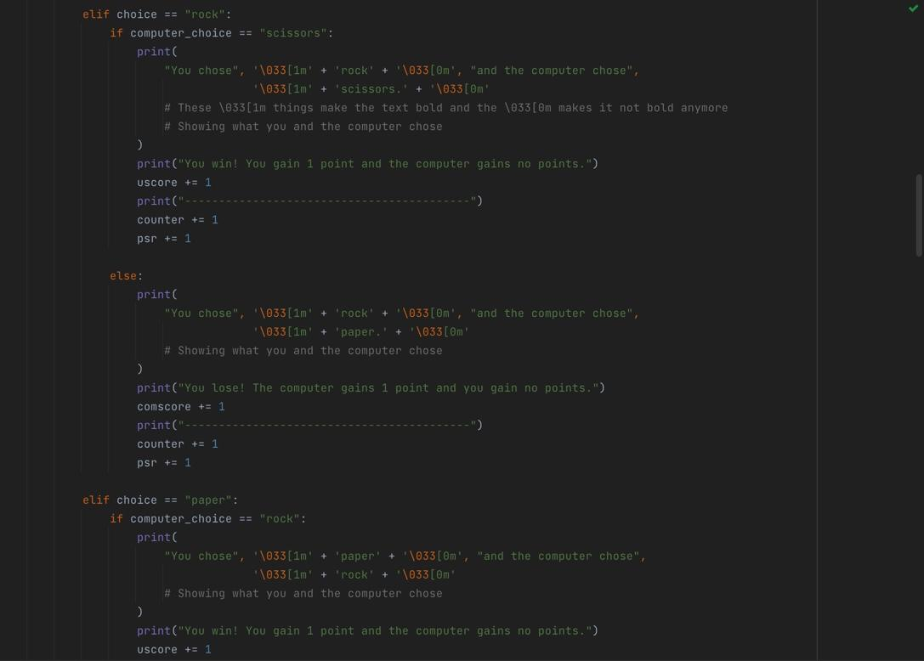
These are some more choices that the user can make. You can see that when the user makes the choice it shows them what they chose and what the computer chose, and that the score goes up depending on what the user/computer chose. The variable ‘psr’ always goes up because it shows the rounds.
Once again this was very basic and I didn’t have to do much work for this section, and I had no problems with this code at all.

Slide 28
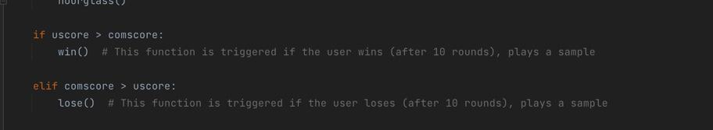
At the end, if the user wins, the win() function that was mentioned earlier will be triggered
If the computer wins, the lose() function will be triggered.
Else, there will be a tiebreaker. More on that in next slide:

Slide 29
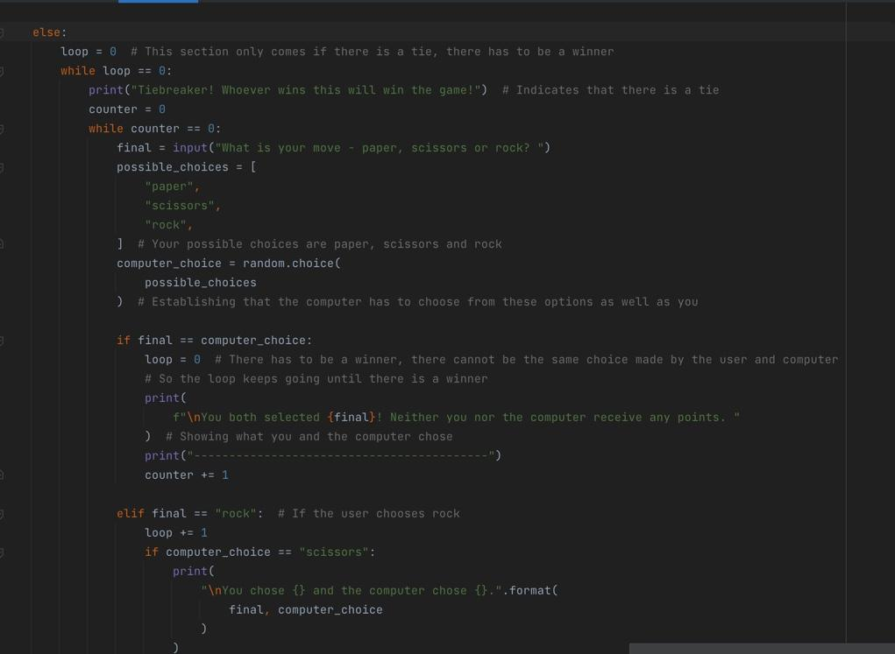
This is what the tiebreaker looks like - it has the same features as the main paper scissors rock loop. You can see that there is a variable called ‘loop’ set to 0, which makes the loop go on until the user’s and the computer’s choices are different - below, the variable called ‘final’ is where the user enters the choice they want to make. If it’s equal to the computer choice, the loop will keep going because there is no winner. I set the loop equal to 0 because of this. However if the choices are different the loop will go up by 1, breaking the loop and therefore there has to be a winner. The same statements from last slide will print depending on the winner.
I think this was a smart move to make because with every game, there has to be a winner and a loser so I have made this happen if both players get the same score.

Slide 30
Number Quiz screenshots with Explanation

Slide 31
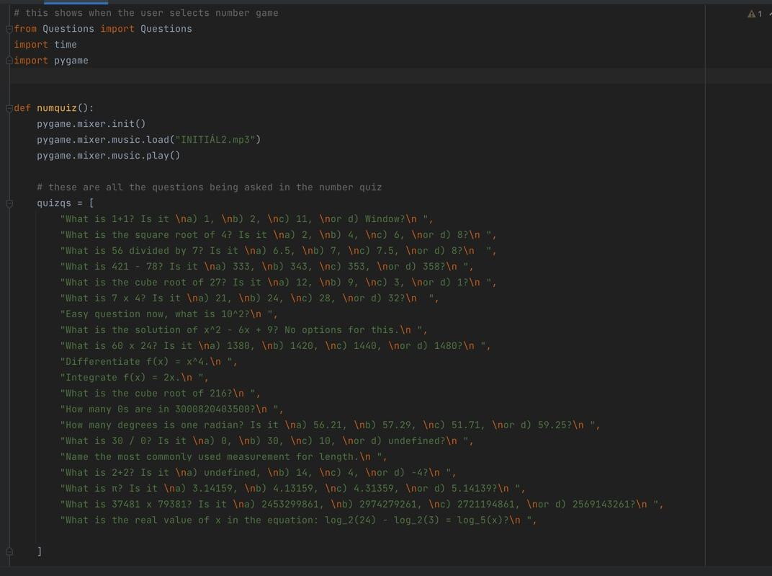
I have three libraries that I have imported at the top of my file - one of these is a file called Questions which I made - I will explain this in another slide. I also imported time - I made it so that this quiz was timed. I also imported pygame to play the music in the background - same as all my other games.
At the start, I make a function with everything in the quiz, so this can be called from the mainarcade file multiple times. I set the pygame mixer to its initial settings, then I load one of my tracks which will play in the background. Then I play the track.
I have made a list with all of the questions in the quiz, called quizqs. You can see all of the questions here. They vary in difficulty, starting off as easy and at the end, the questions are a bit of a challenge.

Slide 32
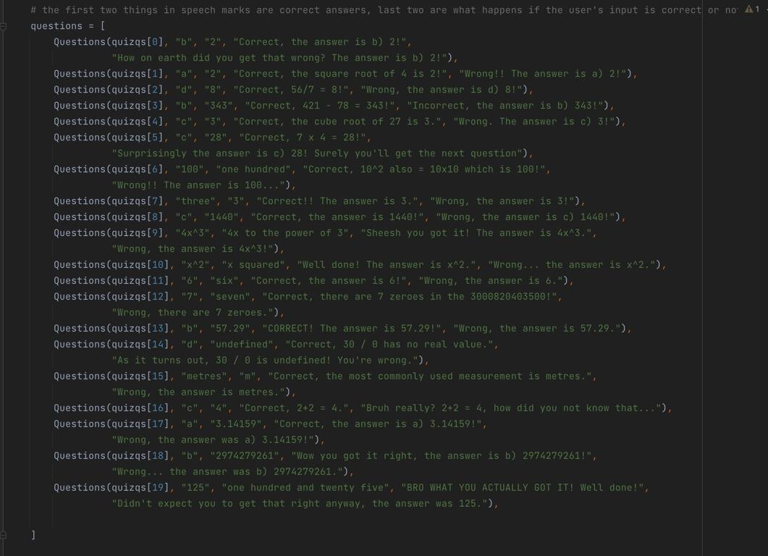
I have another list called questions, which holds all of the correct answers, the correct statements and the wrong statements. I call the questions file with the quizqs list, and the number at which the question is located. For each question in Questions, the first thing in quotation marks is a correct answer, it will most likely be the letter if the question is multichoice, but if it’s not multichoice it just says one of the correct answers. The second thing in quotation marks is also a correct answer, if anyone decides to type the number then it’ll be correct as well. The third thing in quotation marks is the correct statements - it prints if the user gets the question correct. The fourth thing in quotation marks is the wrong statements - it prints if the user gets the question wrong. Then the specific element in the list ends and the next question is called.

Slide 33
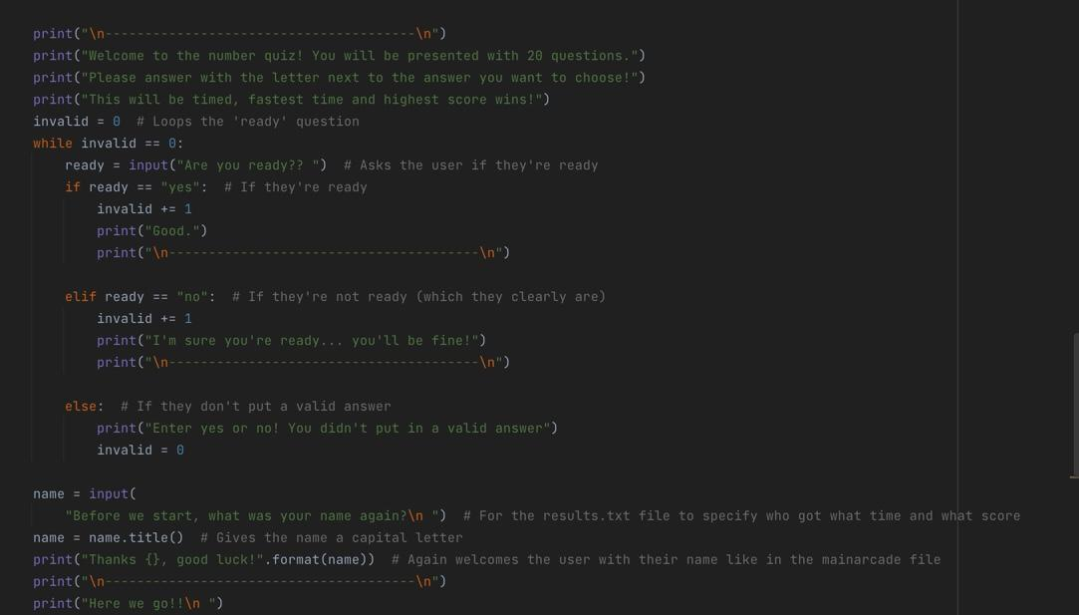
This is the first code that the user will see when they run the program. They will be welcomed, and told they have to complete 20 questions, requiring the letter next to the answer (if there is one, it takes the answer as is regardless). It also says that the quiz will be timed - as you saw before I imported a library called time which will measure the user’s time to complete the quiz (in seconds).
It will then ask if the user is ready - I have used an ‘invalid’ function again which makes the user have to choose yes or no. Regardless, both of the options take the user to the quiz. If the user chooses an invalid answer the question comes again and the only way for the user to get in is if they choose a valid option.

Slide 34
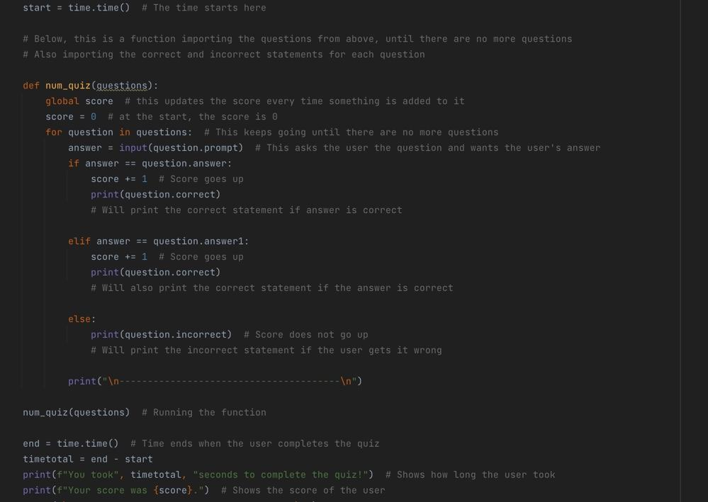
The time starts using the time.time() command, stored in a variable called ‘start’.
This function here is the actual quiz. The score starts at 0, but I use the command global to update the score as the user gets questions right. I used a for loop to go down in
The function is then called using the name of the function.
At the end, the time stops, again using the time.time() command, and this is stored in the variable called ‘end’. The total time is then stored in a variable called ‘timetotal’, which is the end minus the start. Then, it shows how long the user took to complete the quiz in seconds. It also shows the score that the user got from the quiz.

Slide 35
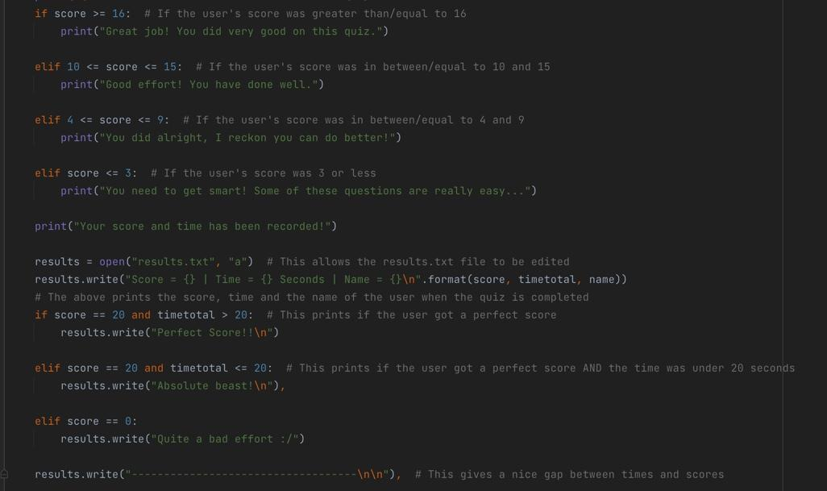
This is what prints if the user gets a score higher than/equal to 16. I congratulate the user on their achievements - it was somewhat a hard quiz so they deserve it. The ones below are if the user gets a score in between 10 and 15, 4 and 9, and if the score is below or equal to 3 I tell the user that some of the questions were really easy and they shouldn’t have got a score as low as that.
I then record their score and time in a file called results.txt, which I open using a command called open, then I put in what I want to open and in the second set of quotation marks I put “a” which stands for append. With this command I’m able to edit the file. In the line below I use results.write to write what I want in the file, for this I wrote the score of the user, the time that they took, and the name of the user to distinguish between different users if they got the same score and time. If the user got a score of 20, I also write “Perfect Score!” in the results.txt file and depending on the time they got, if the time total was less than 20 seconds (which is quite hard to get), I call them an absolute beast because they’re really smart. If the score was 0 I wrote “Quite a bad effort” because realistically, no one should be getting a score of 0 on the quiz.
At the end I wrote a line with two new lines at the end to evenly separate all of the results that the different users got. I’ll show what the results.txt file looks like in the next slide.

Slide 36
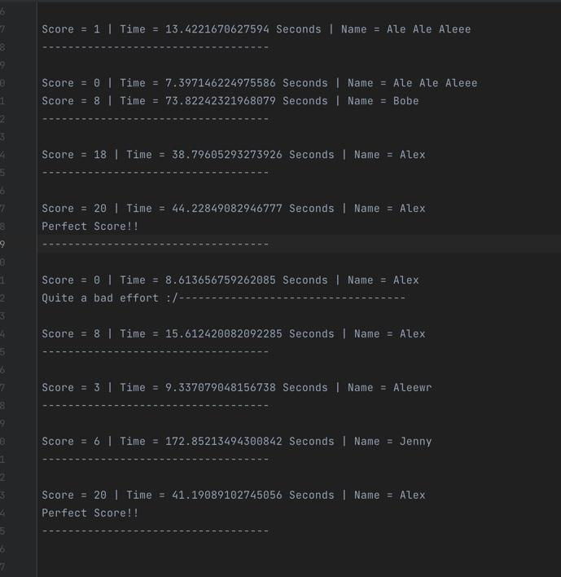
Results.txt File output
You can see here that there are multiple different results I have already stored here. These are all evenly separated (except for one minor thing but that was before I changed the code to separate the 0 and 8 scores (honestly not sure what happened there)), and another minor thing which didn’t put the line after ‘quite a bad effort’ after I’d scored 0. But both of these can be ignored, they still printed the score, time and name as I’d wanted them to print.
You can also see that there are varying scores and a couple of perfect scores which I printed ‘perfect score’ along with the person’s score of 20.

Slide 37
Testing: Feedback and Run-throughs

Slide 38
Feedback from end users (All on the 29th June):
Callum - needs to be a function to exit the code better, bold text to make it easier to read, need to make paper scissors rock game a function to cut down code. Otherwise good. Hard to break. No errors
Mum - didn’t know that I had to press enter, delete the duplication of the ‘do you want to play a game’ when i’ve already selected that i do, very good though
Jamo - it was very good, and i really like it. Needs more expansion. Very good game though. Likes the simplistic style

Slide 39
Video Run-through of the Arcade (Before Final Modifications, 29 Jun)

Slide 40
One component that I spent a lot of time on and changed with the feedback I received
On the last day before I could submit (30 June), I still couldn’t make my arcade play more than once (each game could only be played once before the code was broken). However, I managed to find a way I could do this (through one of my friends who suggested that I do this). I will explain this in the video later but I made all of my games functions. This is because functions could be called multiple times and the standard “import ____” could only be imported once. This made my program a lot better because if a person failed a game or wanted to play the game again they won’t have to take as much time as before to get from one game to another.
This took a lot of time because there are many imported files in my adventure game, but after 30 minutes I’d replaced all of the commands from “import (file)” to “from (file) import (function)” and then calling the function in the next line. I think this was a worthwhile decision, it made my life easier when I tested it. The only negative is that I can’t play the game directly from the file it’s in without changing some of the code, but to be honest it won’t really make a difference because the whole arcade was designed to be played from the menu.
It took a long as time to find this way to make it happen, that made me stuck in some lessons, but it was all worth it at the end. I would rather use this version of the arcade than the version that was only able to import things once, it would’ve made more sense for the games to be able to be played more than once.

Slide 41
Another component that I decided to change entirely
When I was first planning the arcade I wanted to make four games - at the start I originally wanted to make a number guessing game where the user had to guess a number from a specific random selection. I looked it up on the internet to see if I could gain some inspiration, but when I tried it for myself I found myself going backwards because when I ran the code I’d got everything wrong. So I decided to switch that game up to the number quiz - I’d had prior experience in making quizzes in Python so it’d be a lot easier for me, however last year my quiz was majorly if and else statements, and the code was really long. However I learned a process which involved the questions being in lists so I decided to use that, and the code worked even better than last year’s code which I’m very happy with.
From this, I can conclude that this was a very good decision to make and it would’ve put way less pressure on me. I feel like the number guessing game would’ve messed up my code, I just didn’t understand how I’d make it.

Slide 42
What didn’t end up happening
I mentioned before that I’d wanted to make four games, but one of these games I didn’t end up making in time. I originally planned on making a chess game as well as my three other games. I left it for last but that wasn’t a wise idea. I had no experience with GUIs before so that would’ve been a nightmare for me if I’d chose to make it, let alone making all the pieces move like a chess game and the capturing motion would’ve been very weird.
I scrapped that idea and then tried to make a Tic Tac Toe game (with not much time left either!), which I thought was going to be easier than Chess. It was easier to kind of get going, I’d somehow made the GUI work, but I wouldn’t have finished in time. I got some of the buttons working but I didn’t understand the commands well enough to make them work in a tic tac toe game. So I had to unfortunately scrap that idea too.
From this experience I’ll practice with GUIs so next year, I’ll be able to make a bigger and better project in Python, and I’ll be able to use my better experience with GUIs in this project too.

Slide 43
Paper Scissors Rock - Before and After Videos
I made a huge change to my paper scissors rock game throughout the experiment, instead of copying and pasting my original code 10 times, I made a while loop making ‘psr’ less than 11, to save space and to make the code look better. I explain everything in the videos below.
Original Version⬇️ Updated Version⬇️

Slide 44
Lines being too long?
A confusing error I had to encounter while I was using Mu was sometimes, the code apparently had too many characters in one line. However the code worked fine and I did not encounter any problems during the running of the code. To be honest, I felt like this was an unnecessary error and these errors can all be ignored.
I then switched to Pycharm (not because of that), and I soon realised that this was a lot better than Mu because there was no character limit in the lines which helped me out a lot. It also had a built in validator which really helped me fix up my code - I was able to know how to solve the errors unlike in Mu which just showed the errors but no real way to solve it.
I discuss more things that Mu failed to do well for my code in the next slide, and how Pycharm made these much easier.

Slide 45
Mu vs. Pycharm (Discussion)
I downloaded Mu as my original Python code editor because that was the first one that Miss talked about. I felt like it worked well but as my code progressed, everyone around me who was using Pycharm was making a lot more progress than me. Soon, I couldn’t find a way to get music playing in the background, I installed the necessary packages to what I thought was playsound but in Mu it didn’t work, so I switched to Pycharm. It didn’t work there either but I had managed to find another way to play sound, through Pygame.
I kept working on Pycharm for the rest of the assessment and it was so much easier to use than Mu.
Firstly, the built in validator system in Pycharm is 10 times better than Mu’s system. Explained before, it showed me what I needed to change and how I could change it. In Mu, I was left with some unnecessary errors I couldn’t get rid of, no matter how hard I tried.
Secondly, in Mu there were different zoom in/out settings on the code but to be honest I really didn’t think any of those settings worked for me, the code and where the code ran from ended up being too big on a fairly normal setting, and too small on the setting I worked on. In Pycharm, however, everything worked way better than Mu and the default settings for zooming in/out was completely fine for me and while I was working on the code I felt more comfortable.
Thirdly when I was running the code in Mu, my choices for the input statements seemed to blend in with the code too much, all of the font was the same colour. But in Pycharm it was obvious that I could see what I’d chosen, it was a nice green colour and everything else that the code displayed was white. In Mu it was all white which didn’t help because sometimes if the user types something that looks similar to the question, aesthetically it won’t be pleasing for the user so Pycharm has done a much better job here.
Finally the version history on Pycharm is really useful, compared to Mu which doesn’t even have that feature, which has made my decomposition slightly harder, I’ve had to delve deep into my memory to find when I did what.
I would highly recommend Pycharm over Mu for any coders. To be honest, it probably works better than any other code editor, but Mu and Pycharm are the only two I have experience with.

Slide 46
Mu vs. Pycharm (Version Control)
This discussion before also links to version control. I have a version of my code saved on Mu which I discontinued after I’d switched to Pycharm. However due to some of the reasons listed before, if I had the two versions exactly the same I still wouldn’t submit Mu’s version. I couldn’t find a way to reduce my line lengths which were not a problem with Pycharm (on Pycharm it didn’t show that error which made this a lot easier). If I’d kept working on Mu I would’ve had to deal with that error throughout the code, which I would’ve gotten really annoyed with. I doubt I would’ve got rid of that error when I had to make the final changes to the code.
My main version on Pycharm has all of my updated features since I switched to Pycharm from Mu, I was able to get rid of the majority of the errors, and it felt easier to use, so this version would make the most sense to submit.
There are other versions of the code I have saved on Pycharm but it would still make the most sense to submit my most recent version with the most refined code. On the versions prior there are minor errors and the options for some of the games were not completed, but with my most recent code all of the games are complete with as little errors as I could make. You’ll see in a video later explaining errors in my code.

Slide 47
Logins
At the start of my program, I ask the user for their name. This can be any combination of characters that the user chooses, it’ll take letters, numbers and anything else. If the user has a letter at the start of the name then it’ll be capitalised through the name.title() command. I have not leaked this information anywhere - the only places that the names are stored in is the ‘feedback’ section (even then it only asks for the name and their rating of the arcade), and the results text file if the user plays the number quiz. I have not asked for the user’s email, age or any other personal information - it is an unnecessary feature that I won’t need in my code. However having the user’s name will be useful to distinguish between the different users and their ratings, and the number quiz times and scores if the user plays that game, it shows who’s who.
Ultimately it’s down to the user what they choose as their name. They can guarantee that their score/time/name/survey etc. will not be shared to any outside sources.
I also ask the user to type ‘x’ at the start of the code to get in but that isn’t stored anywhere, getting into the arcade is evidence that the code’s worked.

Slide 48
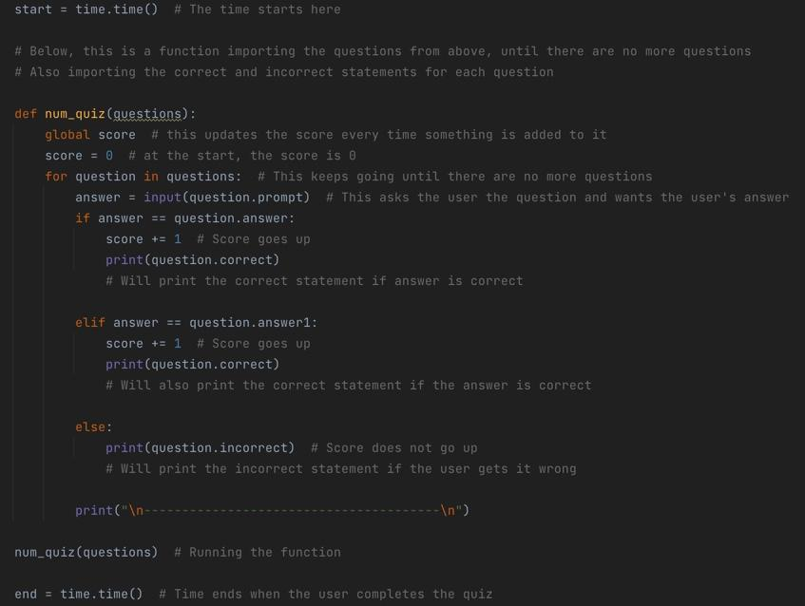
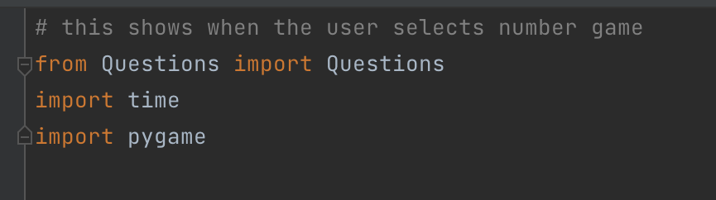
Import Libraries
One of the things that really helped my code was importing different libraries. In my paper scissors rock game, I used the ‘random’ library so that the computer had the same choices as the user, using the random.choice() command.
To play my music in the background I had to use Pygame, this was an external library. This really helped me out a lot because without this I would’ve had to go through a lengthy process to play my music - it would’ve took longer to set up.
To time my number quiz, I used the time library which is a built in library. I used the time.time() command to start and end the time. This was a wise decision to make, I don’t know if there are any other good libraries that allow this.
Evidence next slide for random and pygame, couldn’t fit it all on here!
You can see at the top and bottom of this image I use the time.time() commands to start and end the time. The image to the left shows me importing time in the quiz

Slide 49
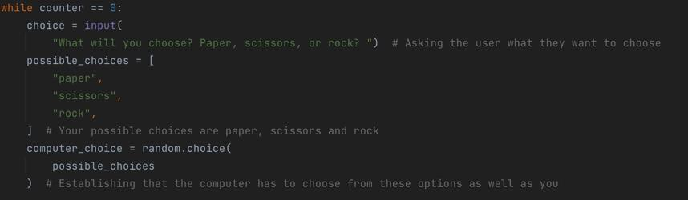


Import Libraries Evidence
The bottom image above is the import statements for my Paper Scissors Rock file, and the top image is the random.choice() command being used in the project.
You can see above how the pygame mixer works. To start I have to set the mixer to init(), this sets the mixer to its initial settings. Then I load the track in the next slide, using pygame.mixer.music.load(“(track)”), and finally I play the track using pygame.mixer.music.play(). You can see in the comments the basic process too. I did this for all of my games, changing the track for each game for a bit of variety.

Slide 50
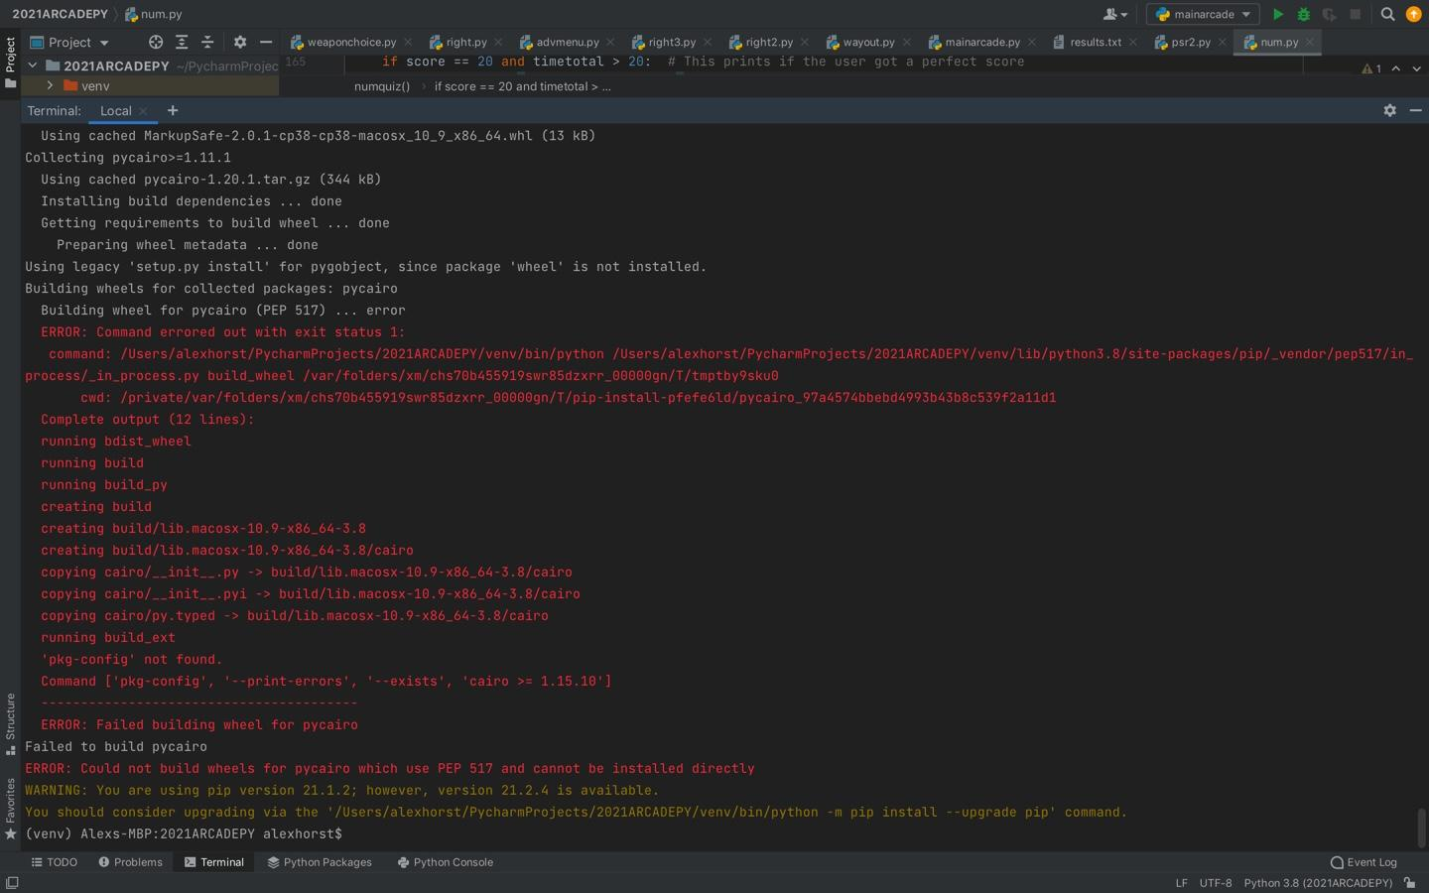
Including music in my program
For each of my games, I had music playing in the background, each track being different depending on the game. I made all of the tracks myself, which made it easy for me to find the appropriate files and put them in the code.
The hard part about this was actually finding a library to be able to play these. I spent a lot of time trying to install playsound, which to me seemed to be the most appropriate library, and the commands (which I would put in the code when I installed it) looked easy enough to use. However, all was not as it seemed. Apart from installing the library playsound, which I had no problem with, I had to install a ton of other programs which I didn’t expect to happen. I had to install a module named AppKit, which somehow wasn’t even allowing me to install it. I had the library required, PyObjC, but it still wouldn’t let me download AppKit. I tried it in the terminal in Pycharm, and the terminal on my own computer, but it still didn’t let me install it, which I found ridiculous. This was not only a problem for me, but for someone else who was trying to get music to play in their program. So I scrapped playsound and moved onto something else.
You can see what happened when I typed pip install AppKit in the image here ➡️

Slide 51
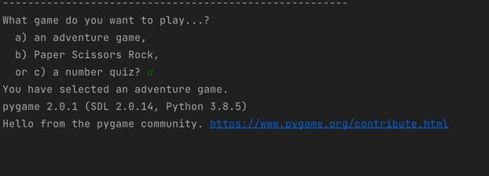
Actually getting the music to play
I gave up on playsound which I’d gotten nowhere with, and decided to try Pygame, an external library. It was rather easy to import and after some brief looking online of how to play music with Pygame, I’d figured out the commands quite quickly, and they were really easy to use too. I think this was a good choice to make because now I was finally able to get what I wanted for the program, there were no bugs or anything like that which I’m pleased with. The only problem I had with it was every time I played music, this statement popped up:
I did not program that to be there but it always popped up every time I got into one of my games. It didn’t do anything to how the game ran but to be honest it was just annoying for me to have to go through that. However the music worked fine so that’s really the only thing I have to worry about - as long as the music is able to be played I’m happy.
From this I can conclude that if you want to get music into your program easily and efficiently, I would recommend Pygame over playsound. Playsound just takes too much time to set up if you don’t have the libraries already installed, and AppKit just won’t be installed which is what you need for Playsound. So I would recommend Pygame even if it means getting those statements every time you use the program.

Slide 52
Something that was unusual
While I was running my code through PEP8 to check the correct validation, I noticed a weird error. In Mu, the character limit is 88, which is what a lot of my lines were over but that can be ignored. What was even weirder was that in PEP8 the character limit was 79. This would confuse someone who wants to run their code through both Mu and PEP8 - which one is correct? Even though this didn’t affect the code it was still a very weird observation that I made.
However there were no other errors when running through PEP8, which was good to see, it didn’t pick up some of the errors that Pycharm did (these errors I talk about in the next section where I use Pycharm to validate the code)

Slide 53
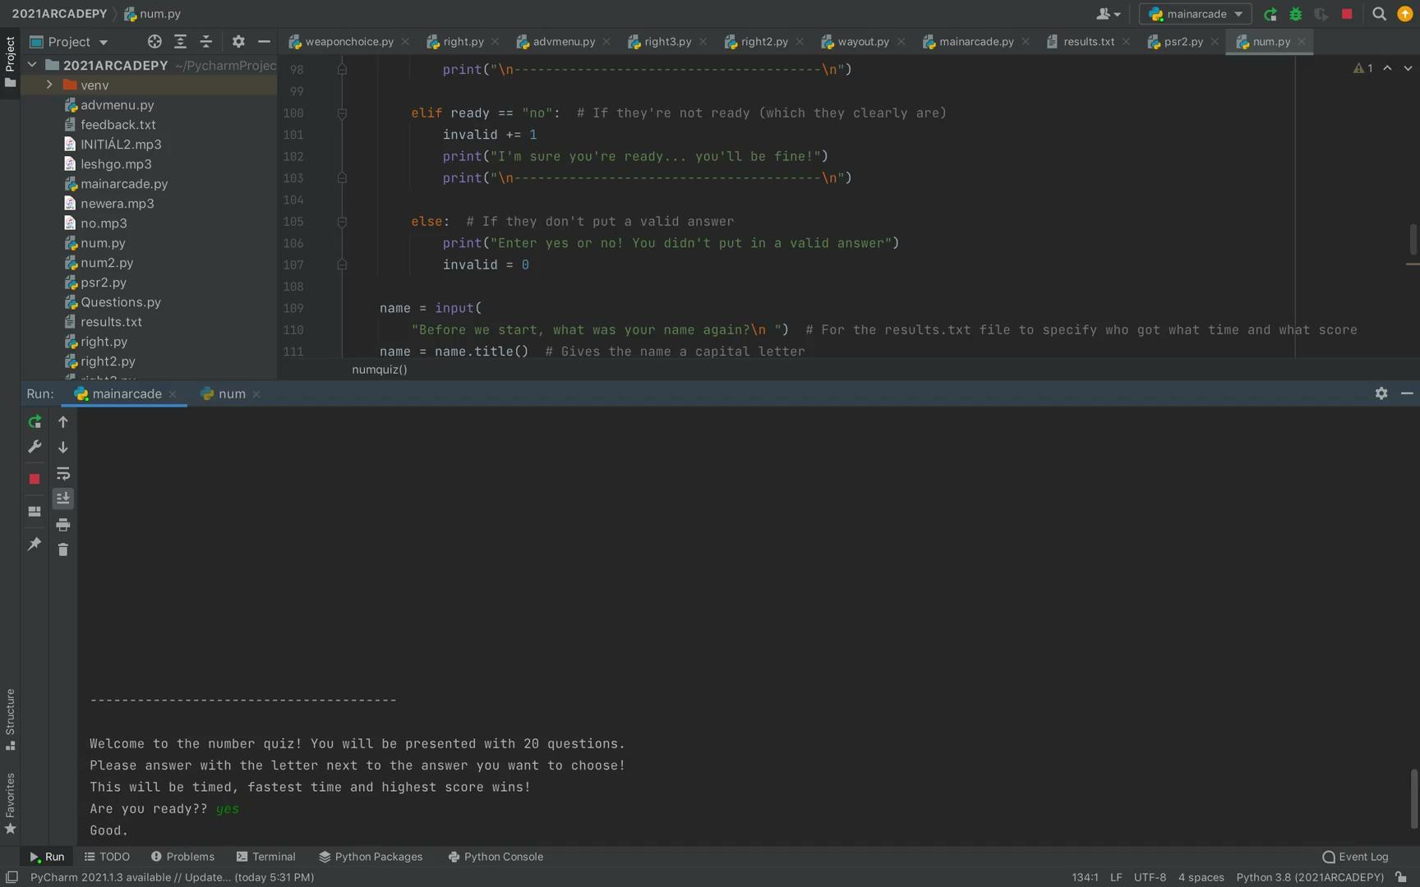
How did I improve my code?
To put it simply, I wanted to do my best to have no errors while still having the code run as I wanted it to. Most of the time I had a few minor errors (I didn’t have any bad errors at all, the ones I had I was able to fix) - but at the end when I was checking over my code I discovered that I could fix all of the errors I had made. This resulted in all but two files having no errors - the errors that were ‘there’ did not affect the code.
I also got my friends next to me to test my program when I needed it, this allowed me to gain feedback from them and thus I could improve my code.
I will show you that there are no real errors in the video below⬇️

Slide 54
Video Run-through of the Final Version (After Modifications, code last edited on 30 June)

Slide 55
Implications

Slide 56
Legal Implications
This arcade abides by the law - it does not contain any copyrighted material.
This arcade has no GUIs, which you have seen in my videos. Therefore this arcade does not contain any copyrighted images, and if I were to use GUIs I would’ve made sure they were from a free-to-use website (such as Pixabay or Unsplash), which I used for the website I made earlier in the year.

Slide 57
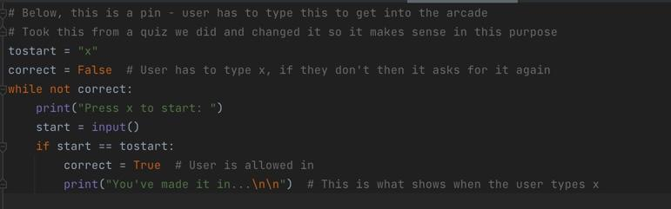
Legal Implications Part 2
At the start of my code I used a PIN to make the user have to type that value to get in. I took it from a quiz that our class did earlier in the year and I have given credit. I have modified it so it would’ve been able to fit in with my code and I’ve simplified the code. You can see this below⬇️

Slide 58
Social/Cultural Implications
The main purpose of this arcade was for people to enjoy themselves and even learn a thing or two. I have made sure that this will be enjoyable for anyone who chooses to play it, and that they won’t get bored easily, there’s three games to choose from, all with probably different outcomes.
There is nothing in this arcade that will make fun of anyone’s culture/race, I have made sure this is the case. The adventure game scenario is made up and I have not indicated any particular culture as to where it was set. It is 100% original.

Slide 59
Accessibility Implications
I have made sure that the user would have a great time while they’re playing the arcade, this also involves making the arcade easier to play rather than making the user have a hard time. The number quiz questions can be hard but I have made it so that multiple answers are okay, for example the question 1+1 accepts 2 or ‘b’ as an answer (b was where 2 was). It is the same for every question - there are two possible ways to get the question right.
I have made sure that the code works well. If a user types an invalid response for anything I’ve made sure that the user gets another go. For example in Paper Scissors Rock I’ve made sure that the user types paper, scissors or rock - anything else will be invalid; and in the menu, the user has to choose a game or it’ll ask again for the user’s option. You can see these in the videos.
If these are not addressed, then people will probably have a hard time getting through my code.

Slide 60
Accessibility Implications Part 2
I have made sure my adventure game works perfectly - I have tested my game many times to make sure I have options for all scenarios, it will not be possible for the user to break the code. You can see me testing the game below twice, each with different choices that I’ll make⬇️ (No sound for this video)

Slide 61
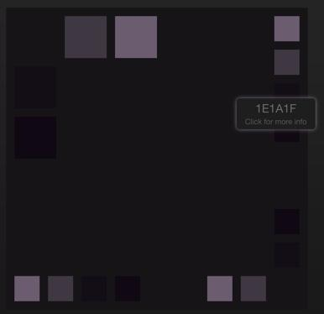
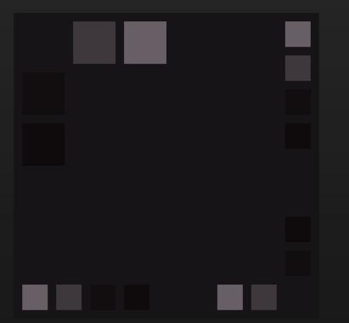
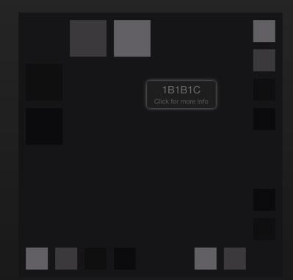
Accessibility implications part 3
Being colourblind should not be a problem in this program - my code runs off black and white colours (there are no GUIs or anything so there are no real stand out colours). I tested the colour scheme that I have on Paletton (colour blindness simulator) and there was no difference in any of the simulations - everything worked fine. As you can see below I have screenshots of three different simulations, and they all look very similar.
This one is normal vision, the one in the middle is tritanopia (0.003% of population), and the end one is dyschromatopsia (more serious)

Slide 62

Accessibility implications part 4
For people with learning disabilities, I have shown them how to get into the game they want, by saying ‘To choose your game answer with the letter next to it’ at the start of the code. This is to make their experience here easier.
In the number quiz I ask the user to answer with the letter next to the answer they want to choose. This is to reduce the amount that the user has to type, however both answers work if they want to type the number too. You can see this below.

Slide 63
Health and Safety Implications
This arcade should not enforce anything on anyone. I did have usage of weapons in my adventure game but it doesn’t visually show any weapons. This shouldn’t make the user want to try out the weapon for themselves in real life, it is not my intention for that to happen. The number quiz suits the health and safety implications just fine - it’s a number quiz so there’s nothing dangerous in it. Paper Scissors Rock is fine too.
Sometimes, users’ hands can get really tired from typing too much on a keyboard. I have made sure that there isn’t too much to type, to prevent this happening. I don’t want my users’ hands to be damaged from having to type too much, it’s not nice and it won’t do the arcade well.

Slide 64
Review/Reflection

Slide 65
Reviewing my code
I believe that my project came together really well. I’m very happy with how it turned out - though I had to make a few changes that definitely set me back, I am very pleased with my efforts. It was not hard for me to come up with this particular project and I’m glad I was able to not have to think too long about this. All of my games work very well, each game fulfilling its intended purpose.
I also think the txt files were really useful for my code - I was able to store the results in there without them being lost forever. If I didn’t have these, no one would know if they did well compared to the other users, and I wouldn’t be able to see the survey results from the different users. So I’ll definitely make sure that this will be a feature in my code next year, depending on my plans for it.
I know there’s some things I could’ve changed - taking into account the time of making the games, project management and taking measures to get rid of those errors I couldn’t get rid of. I’m still very happy with my code regardless but that’s just a couple of things I could have done to make the code better.
I was able to improve my Python knowledge a lot with this project. I think this will set me up for next year’s project and other ones I have to do with Python really well.

Slide 66
Overall Discussion
There are a lot of things I can discuss and take from this project. To get excellence in next year’s Digital Tech python standard I’ll have to step up my coding ability - though it did work well I think it was a little basic in some areas. I did not use GUIs at all this year, but my plan is to learn GUIs so I will be able to use it in my code next year. I think with this knowledge I’ll be able to achieve better, and I’ll be able to make some more sophisticated projects.
In general I had to learn a lot of things for this project. The task took roughly six weeks-eight weeks to complete, and prior to making this I had to re-learn some of the basics - functions to store data, learning how to use txt files (did this while i was making the code), range commands, and while commands - some of the things that I was taught. It wasn’t too stressful though, I was able to pick up most things easily, and I was able to implement this knowledge into my code.
I slightly underestimated how much time the chess game was going to take - leaving it till the end was not a good idea, so I dropped that game from the project. Next time, I’ll spend more time thinking about what’s going to take the most amount of time to set up and what will be easily done, and work based on these thoughts.
I think I should’ve paid more attention to decomposition while making the project. Firstly as I mentioned before, Mu did not have a place where version history could be found, so I should’ve started my project in Pycharm rather than Mu. Secondly I didn’t have a way where I did decomposition throughout the project so I really think I should’ve used Trello or Monday or something like that where I could record things as I go. This set me back for my documentation so next time I’ll take extra measures to make sure I have a reliable source for my decomposition.

Slide 67
Final words
The testing, decomposition of components, implications and many discussions you have seen in this presentation all contributed towards making this a high-quality outcome. Though not every program is truly perfect, I have done the best I can to make this arcade fun and enjoyable for everyone.
© Alex Horst 2021

